Slide 1
E-Commerce Trends and Analysis
Team Epsilon
(Sunil Williams, Jake Weiss, Jan Lelie, Rumani Kafle, Xavier Walsh, William Fetter, Myat Minn Khant, Chris Bushelman, Molly Pfefferkorn, Chorrkin Chin)

Slide 2
E-Commerce Platform Launch
Team Epsilon has been approached by an entrepreneur looking to launch their own online retailer platform, similar to Amazon. The entrepreneur wants Team Epsilon to use our data analysis skills to generate recommendations for how the entrepreneur can make his new e-commerce platform as successful as possible.
For this project, Team Epsilon analyzed a dataset from Kaggle.com containing data representing Amazon sales in the United States in 2023. The dataset includes categorical data as well as review counts, average ratings, and pricing.

Slide 3
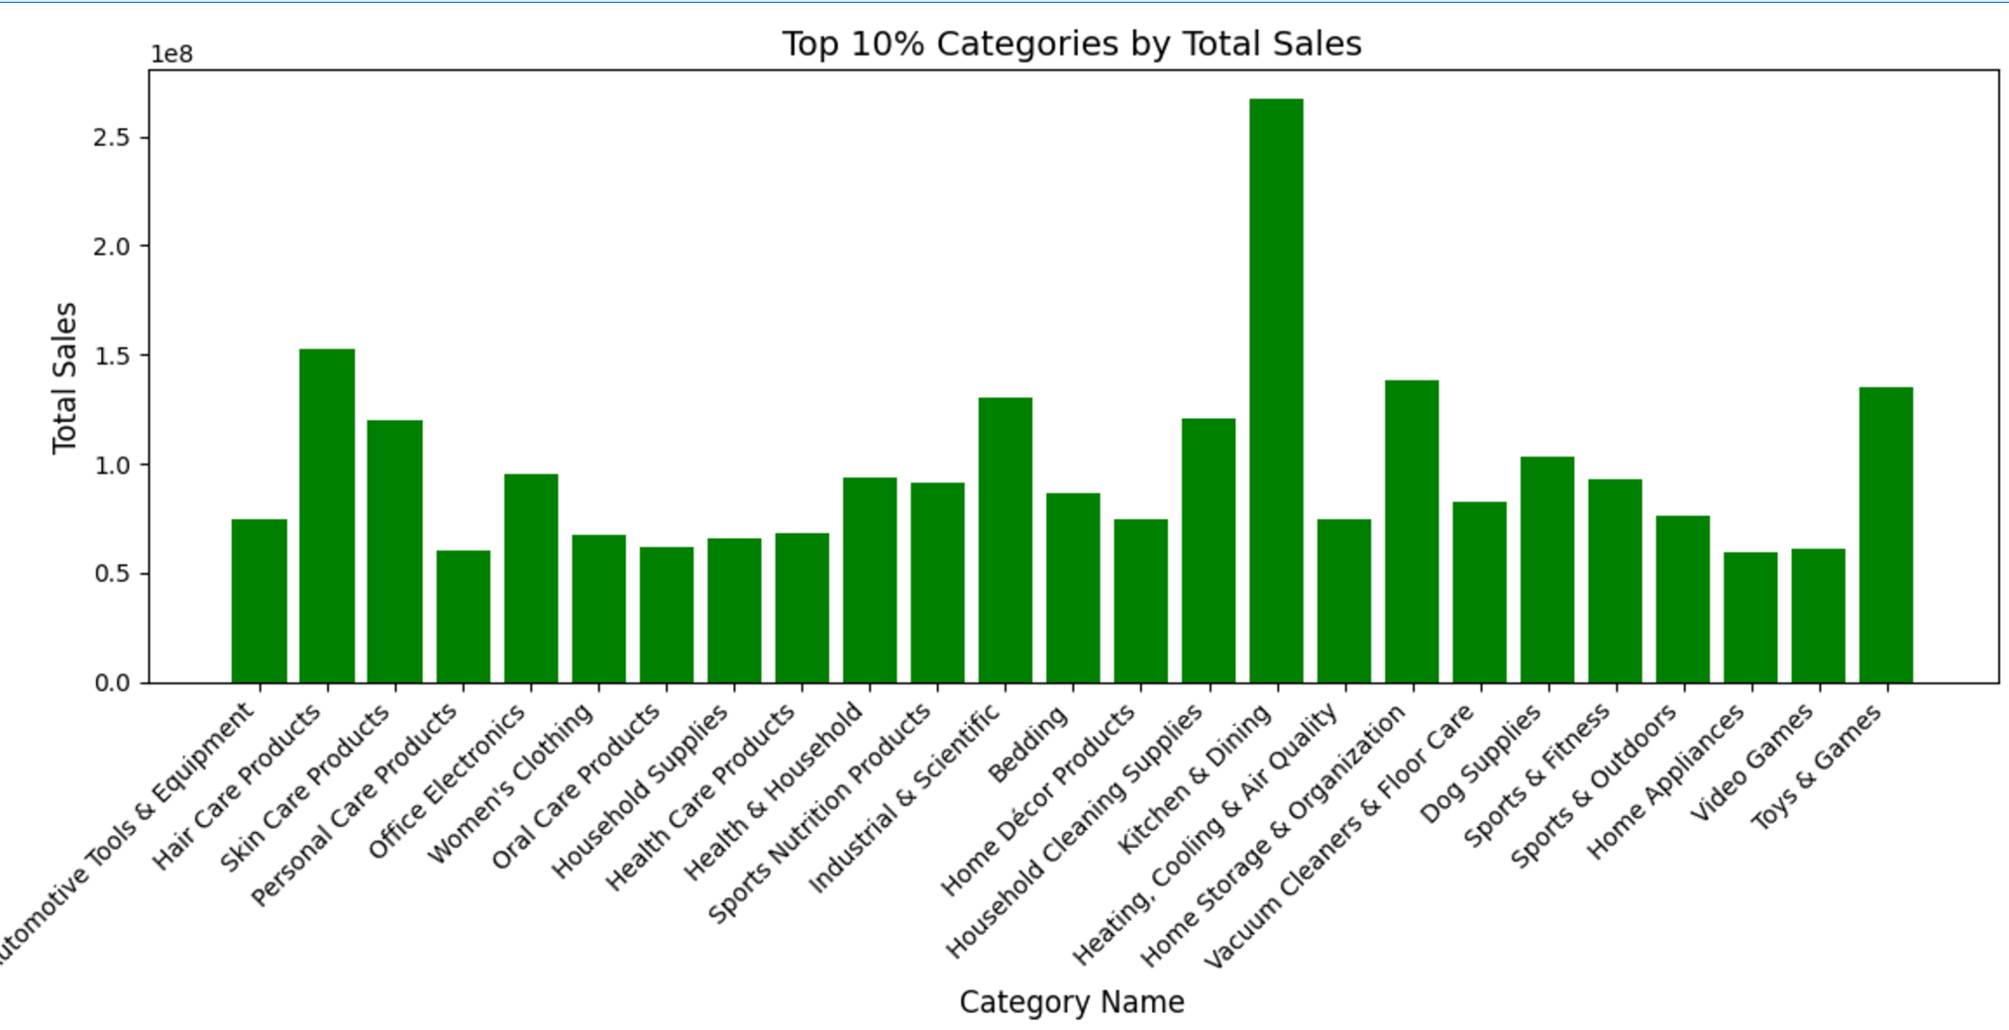
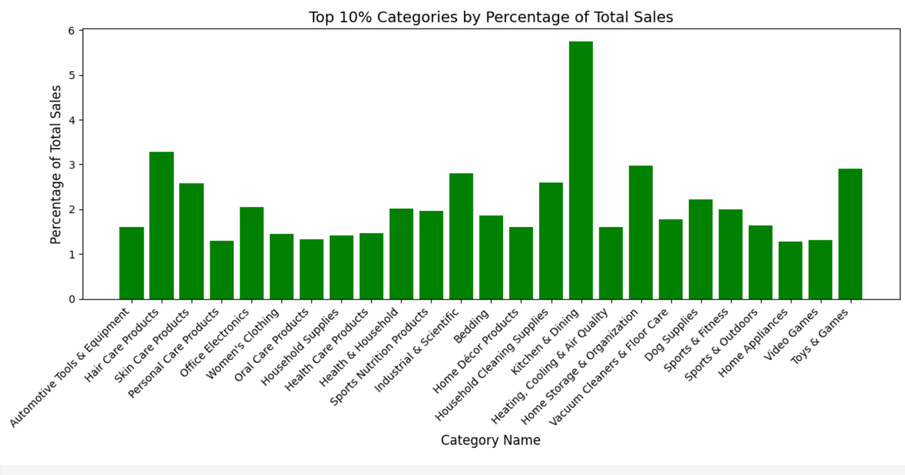
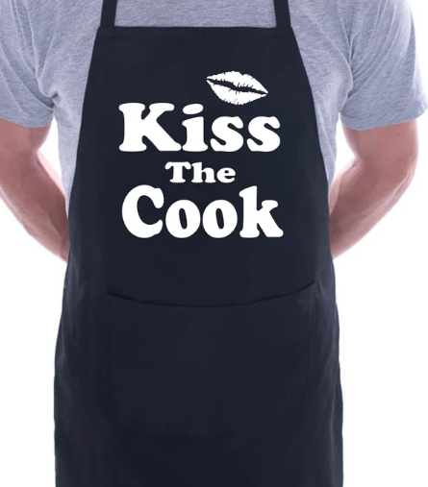
Categories by Total Sales - Sunil Williams
Reviewing the data we broke down the top 10 % categories in total sales as well as what were the top categories by total sales.
Kitchen and Dining, Hair care products and Toys and games were the highest sales totals.
Introduction into e-commerce market would indicate that these categories would be a good entry point in the sales market.
Kitchen and dining had a significantly larger sales total and with the broad variety of items could indicate we start specifically in the market entry.
Notes:
My analytics looked at the total sales for each categories as well as the categories by percentage of sales.
Fine tuning the data, we used our data analysis skills and whittle down the data to the top 10 in these categories. We saw that kitchen and dining was significantly outperforming the other categories. Hair care products and toys and games were strong performers as well regarding total sales. Recommendations would be to start with high sellers for the e-commerce startup.
Sunil Williams

Slide 4
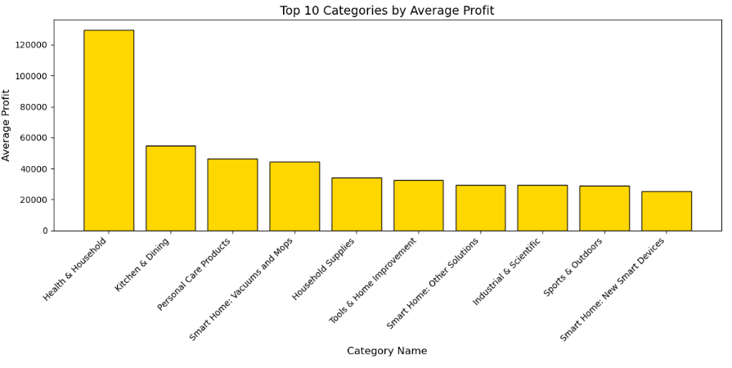
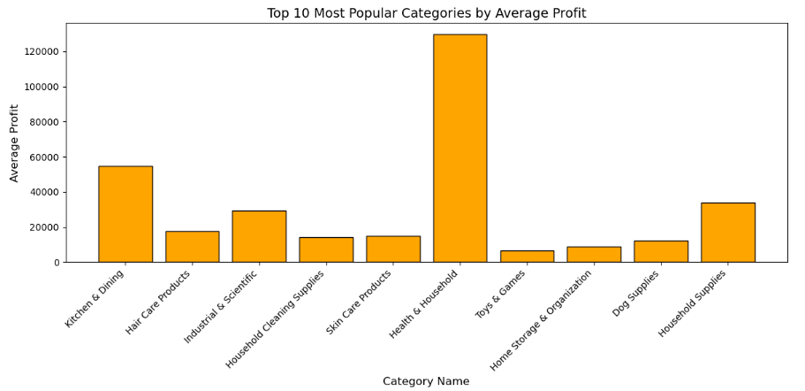
Category Profits - Jake Weiss
Top Graph: The top ten categories with
highest profits on average
Bottom Graph: Top ten categories in total
sales ordered left to right measured by average
profits
Notes:
After seeing Sunil's graphs I looked a profits for each category. Profits being calculated by multiplying the price of the products by the total sold in the last month. Here we can see Health & Household is dominant. On the other hand when looking at the second graph we see still categories measured by average profits but organized left to right by which category had the largest total purchases in the last month. So while one might consider Heath and Household as the category to start in it ranks 6th in popularity, while Kitchen and Dining seems to be on the rise in popularity holding the number 1 spot while still maintaining high profits potentially with room to grow.

Slide 5
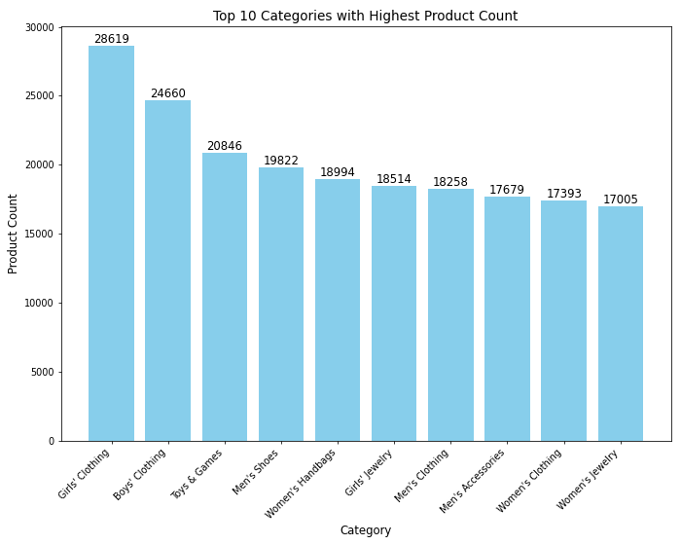
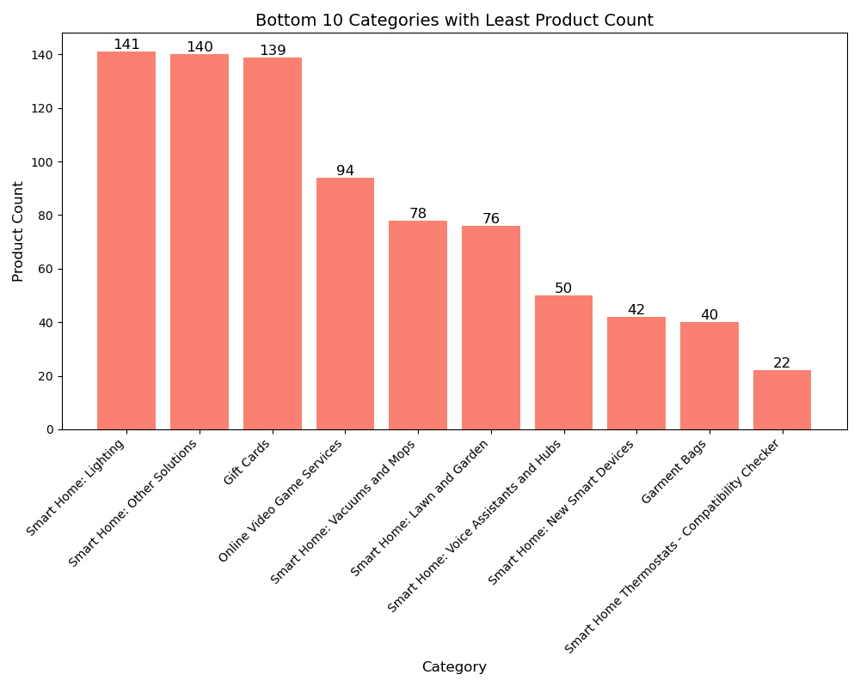
Categories & Products (Jan)
Top 10 Categories with the most Products.
10 Categories with the least Products.
Notes:
(Jan) In analyzing the product distribution between categories, I noticed a clear distinction between categories with high and low product counts. The Top 10 Categories have the largest inventories, likely catering to broader markets with a focus on volume-driven revenue. These categories require careful inventory management and pricing strategies to remain competitive and efficient.
On the other hand, the Bottom 10 Categories have fewer products, which may reflect their specialization or niche focus. While smaller in scope, these categories could offer higher margins or cater to targeted customer segments, providing an opportunity for differentiation and profitability.

Slide 6
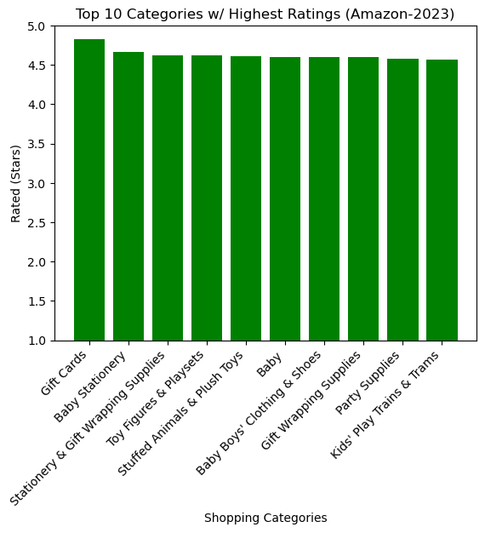
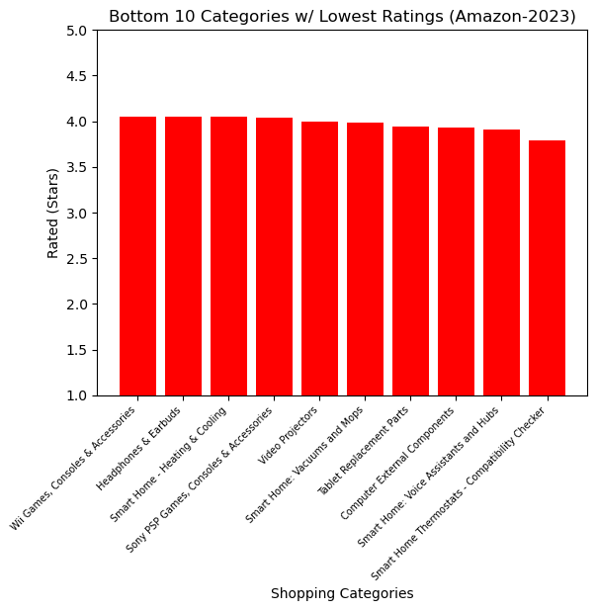
Highest Avg. Rated Categories
Lowest Avg. Rated Categories
Could indicate older or outdated products (Wii)
Highly complex products
Performance factor
Straightforward products with little complexity
Products with high emotional appeal
Majority can be gifts
Rumani

Slide 7
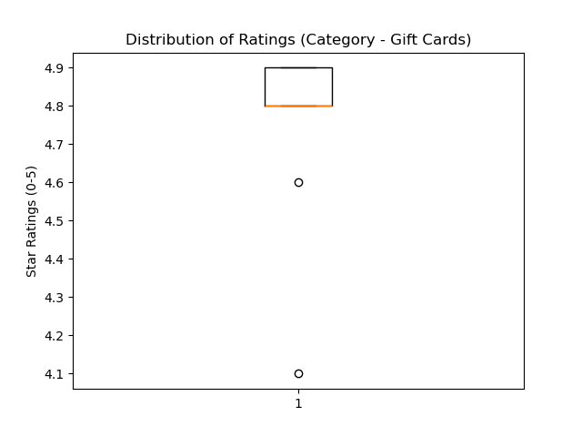
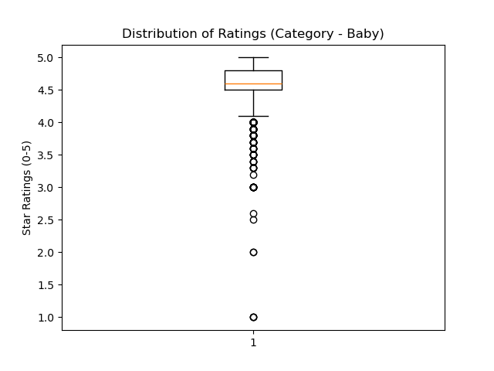
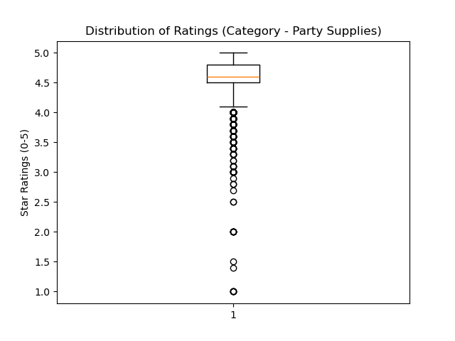
Distribution of Ratings In Highest Rated Categories
Lowest rating = 4.1
No extreme outliers
Data clustered within small range
Height of box = Middle 50% of ratings
Boxes are relatively small meaning less variability in stars
Rumani

Slide 8
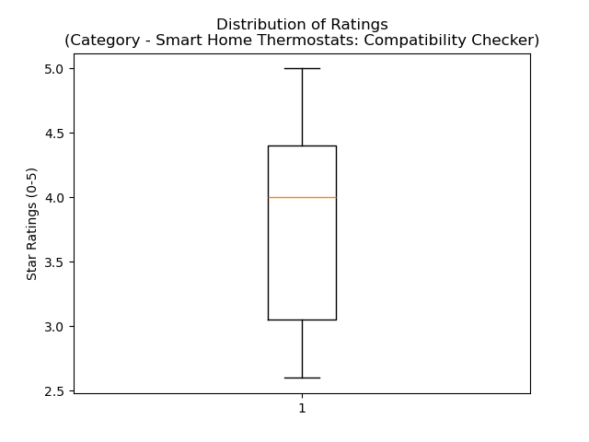
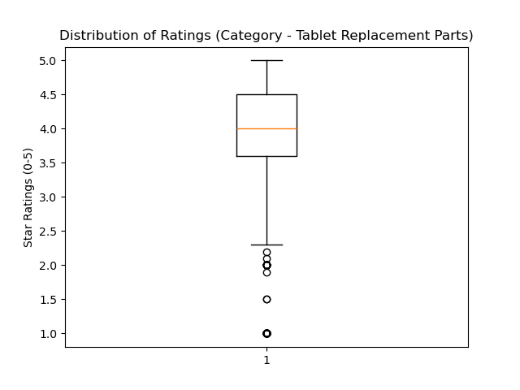
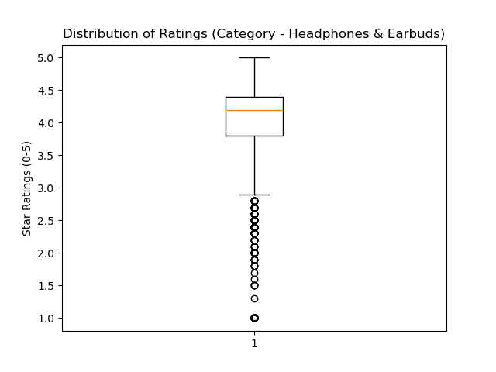
Distribution of Ratings In Lowest Rated Categories
Highly Complex Product
Large IQR = High variability in ratings
Diverse customer experience
Boxes getting more narrow - ratings start getting more consistent
Specific needs/expectations reduce variability
Rumani

Slide 9
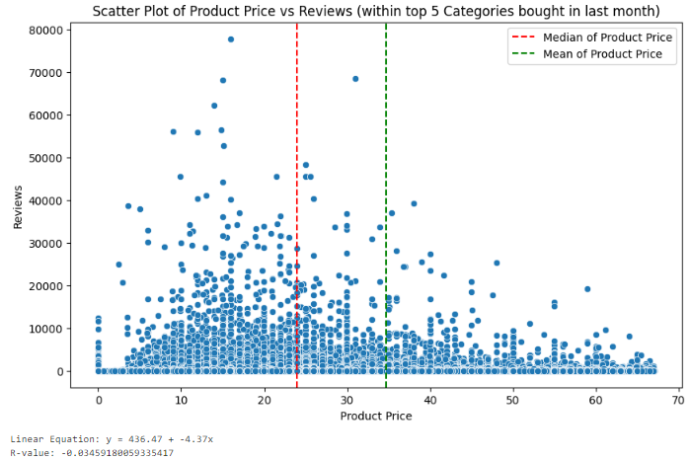
Review of Product Price vs Reviews (William)
No obvious linear relationship exists between product price and the number of reviews received.
The data does appear left skewed when plotted, showing that the majority of the reviews occur with products below the mean value of about $35
Recommend product price point to be near mean value of about $24 in order to generate the highest likelihood of user reviews
Notes:
One of the topics our employer is most interested in is generating the most feedback through reviews received on the products. To research this, we analyzed the relationship between the product price and the number of reviews within the dataset. While no linear relationship was found, we did note that the data was left skewed with the mean product price being approximately $35 and the majority of reviews occurring with products less than this amount. We would recommend in order to have the most reviews posted on Amazon, the desired product price point should be targeted to be about $24, which was the median value noted.

Slide 10
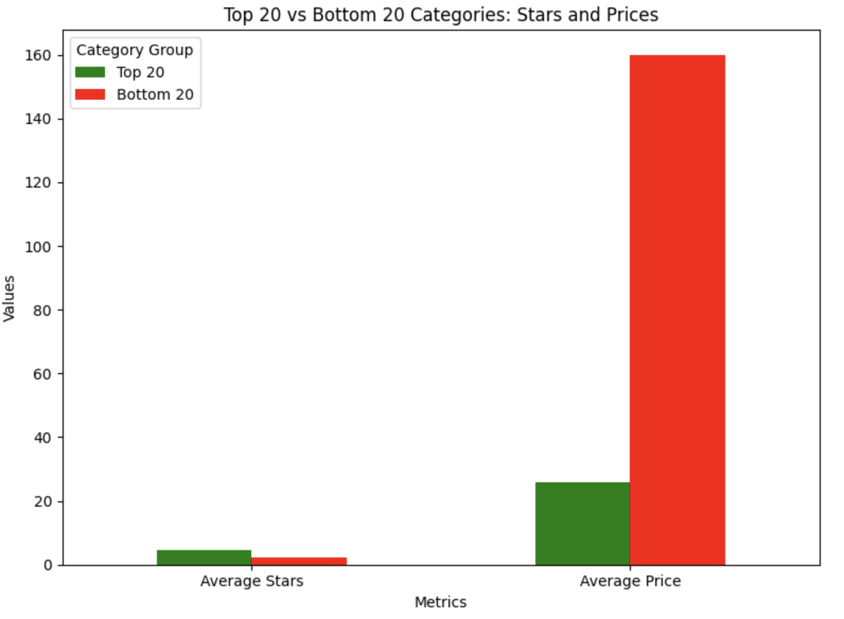
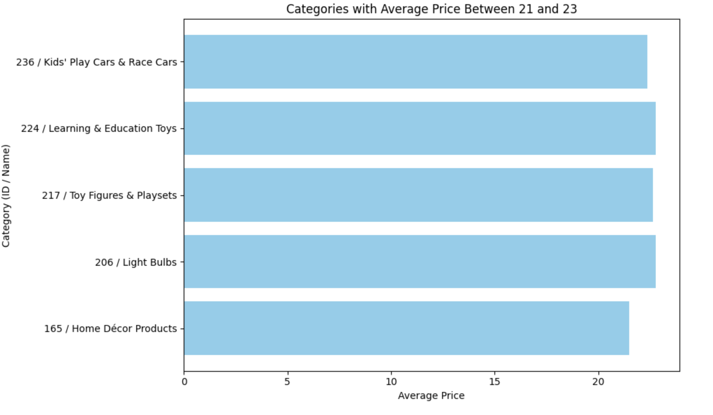
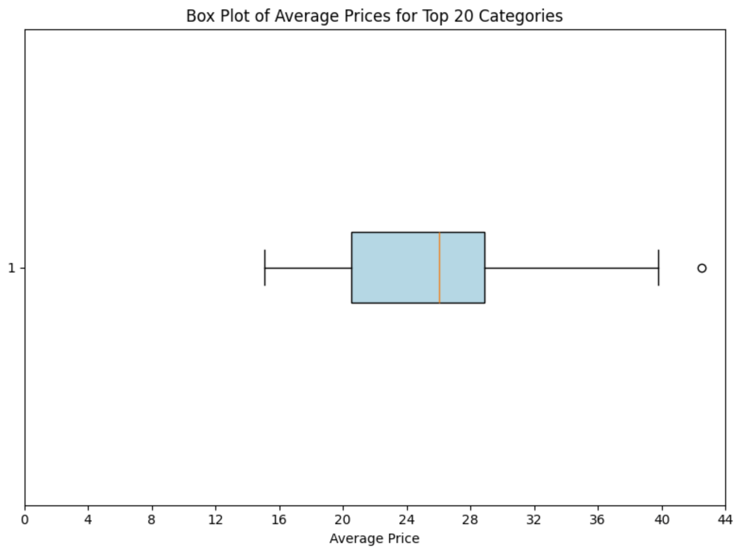
Entry Analytics on Price and Ratings (Xavier)
Correlation between Average Price and Average Ratings: -0.4299
Higher priced products produce lower ratings
Higher chance of success with products that are lower priced
Common items are also more likely to be cheaper and sought after
Kitchen Appliances
Household items
Giftcards
Kids Toys
Notes:
I compared the relationship of Rating and Price. In terms of generating favorability among customers lower priced goods do better for the most part. Looking at the correlation between Average Price and Average Ratings the number tells us that higher priced products produce lower ratings on average. Coincidentally lower priced items that do well seem to be priced in the 21-29 dollar range with the mean value of $22 dollars as seen in William’s numbers. These cheap products tend to be common items as seen in the graph on the lower right.

Slide 11
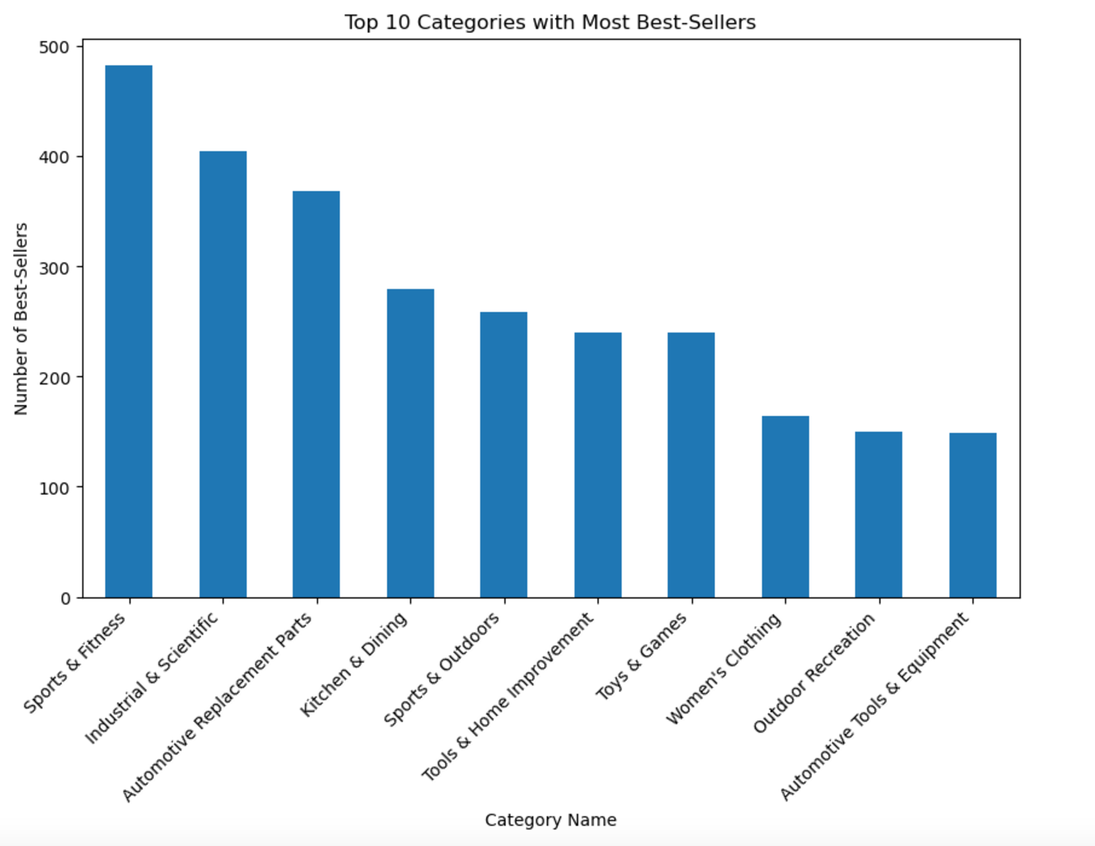
Categories with Top # of Best Sellers (MMK)
Sports & Fitness appears to have the highest number of best-sellers, indicating a strong market demand or consumer interest in this category.
Industrial & Scientific, Automotive Replacement Parts, and Kitchen & Dining also have substantial numbers of best-sellers, suggesting these categories are highly competitive or popular.
Notes:
When we look at the categories with top number of best seller,Sport and Fitness is the most popular and have the highest number of best seller.
Industrial and Scientific, Automotive Replacement Part, and Kitchen and Dining have most significant numbers of best sellers. These categories are highly competitive .

Slide 12
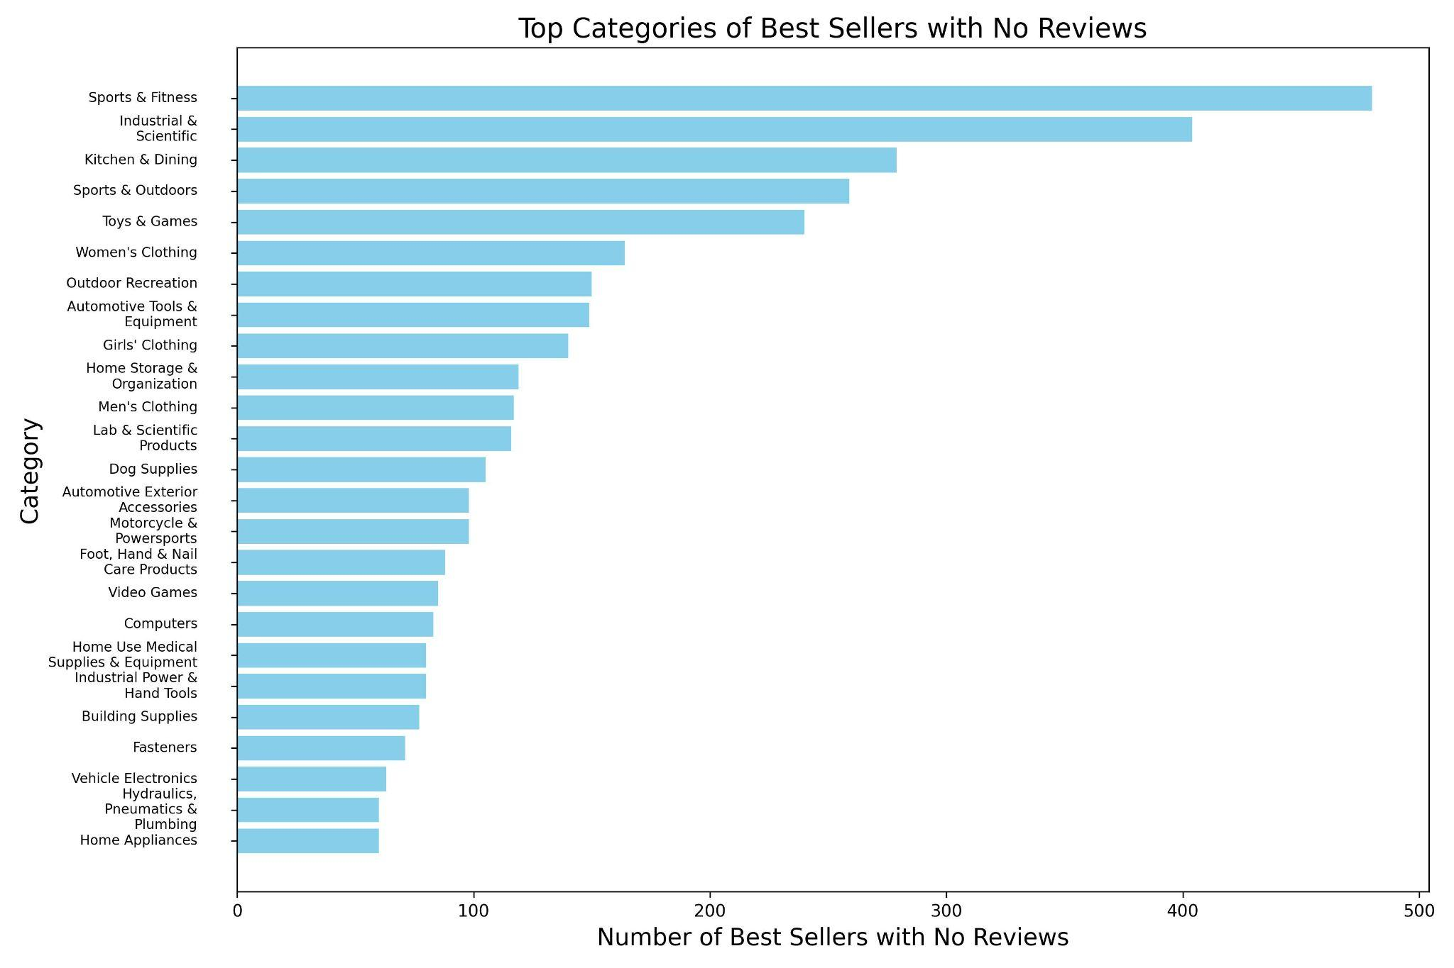

Products With No Reviews, by Category
Products with no reviews: 807,116
“Best Sellers” with no reviews:
5246
Everyday Items? We think so
Image Credit: itsnicethat.com
CB
Notes:
Speaking about reviews, there were a surprising number of categories that had no reviews. Just to look at them, I filtered out the categories with no reviews and checked to see the product offering volume in those categories. There were 807k products with no reviews and 5246 of them were Best Sellers! It is my hypothesis that these items may be every day items. Given the variety of items that sell through Amazon, these could be baseballs, weights, milk, nail clippers, any everyday item. Together we made the decision to filter these out and look at the data that had more customer interaction and feedback.

Slide 13
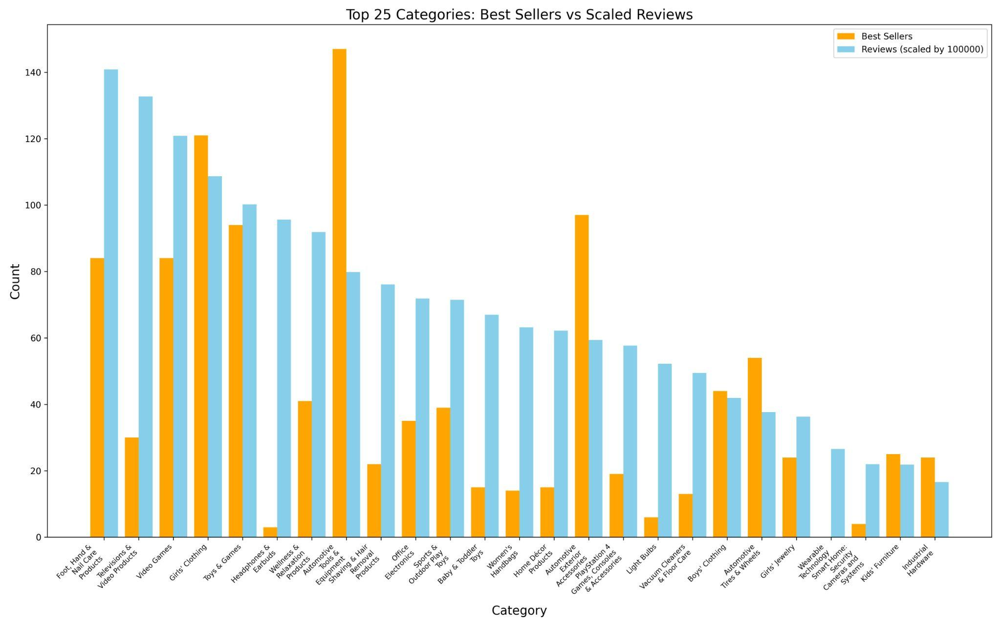
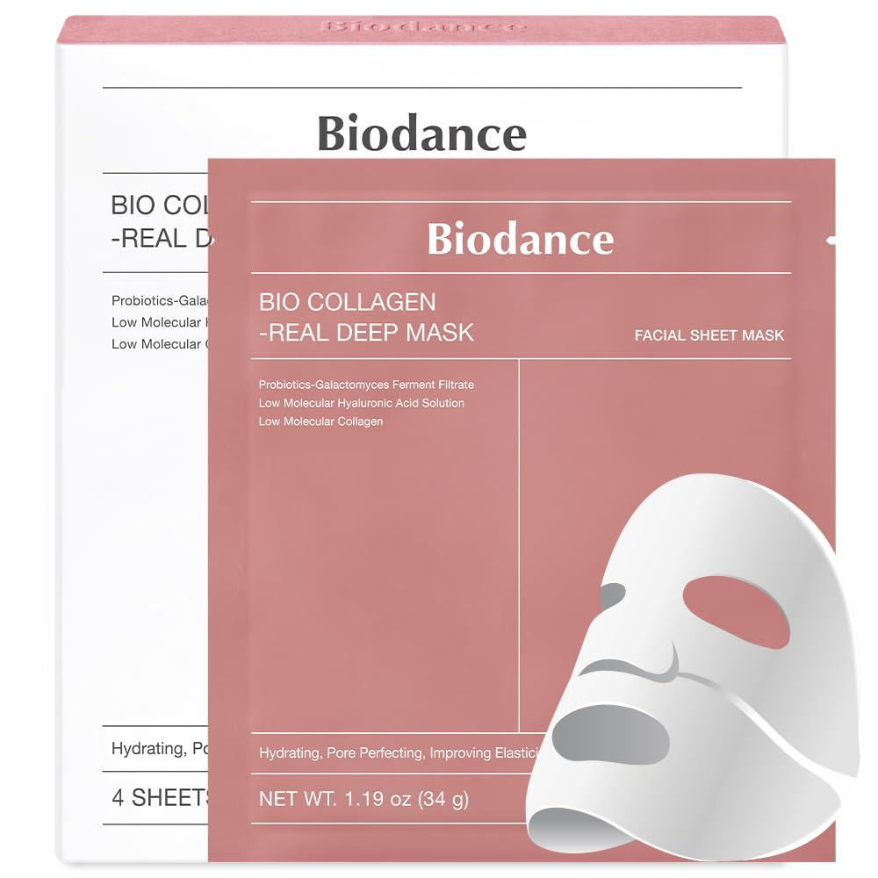
How do reviews impact ‘Best Sellers’?
Correlation: .72
5 Categories with most reviews:
Foot, Hand and Nail Care
Televisions and Video Products
Video Games
Girls Clothing
Toys and Games
Top Seller in Foot, Hand and Nail Care
(image Amazon.com)
CB
Notes:
The main thing we were inspecting was how do other factors influence the sale of products, particularly items in categories that are ‘Best Sellers’. First we looked at the impact of reviews on best sellers. There was a strong correlation between reviews and best sellers (.71), however, a good number of reviews does not a best seller make.

Slide 14
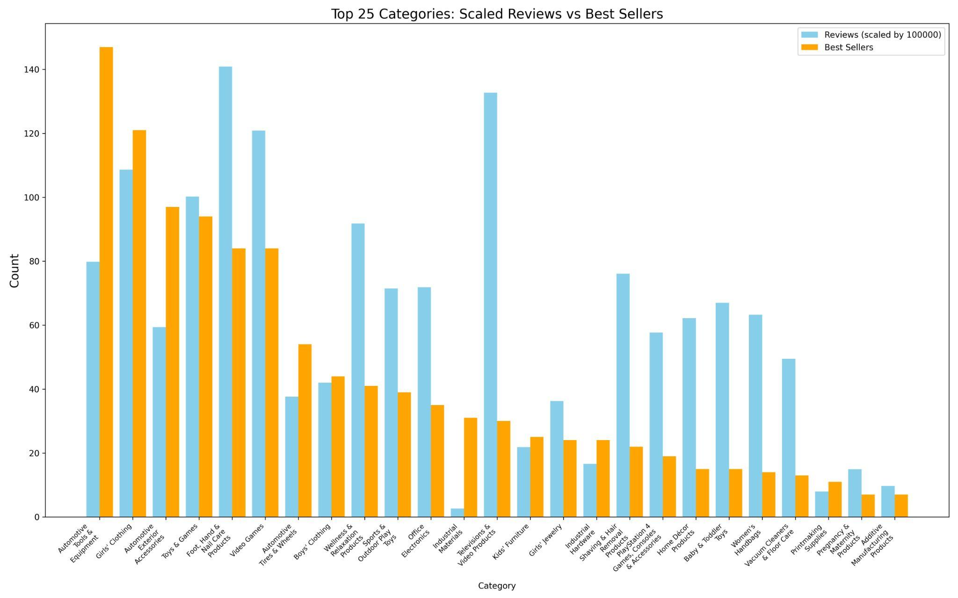

Do the top ‘Best Sellers’ have the most reviews?
*Image Courtesy of ESPN.com
Top 5 Categories with most ‘Best Sellers’:
Automotive & Equipment
Girls Clothing
Automotive Exterior Accessories
Toys & Games
Foot Hand & Nail Care
CB
Notes:
So the best ‘Best Sellers’ must have a lot of reviews right? To quote coach Corso, NOT SO FAST MY FRIEND! As you can see in this chart, some of the top best sellers actually have lower reviews.

Slide 15
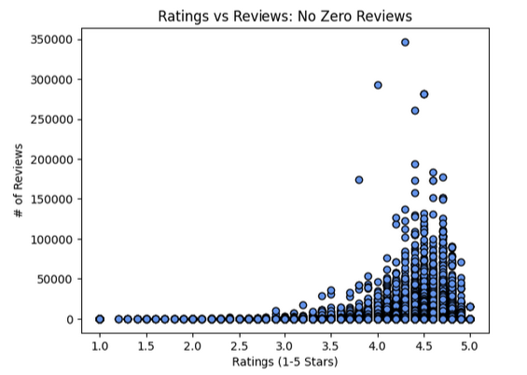
Review Count vs Average Rating For All Sales Data (Molly)
This graph displays the relationship between the number of written reviews a product received vs the average rating of the product on a scale of 1-5 stars.
To prevent data skew, products with zero written reviews were omitted.
Results resemble an exponential growth curve.
Notes:
This analysis looks at the relationship between the number of reviews a product has received and the average rating the product has received. Despite a low linear correlation, we can see that the results resemble an exponential growth curve.
For the next step, I omitted any potential outliers using the quartile method, and looked at the results broken down by category.

Slide 16
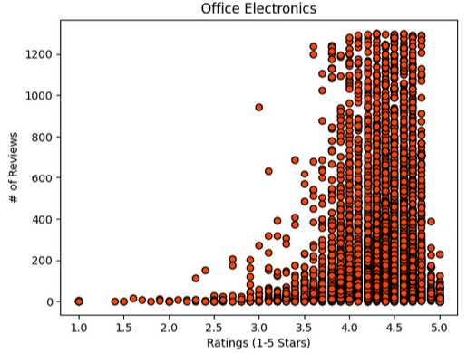
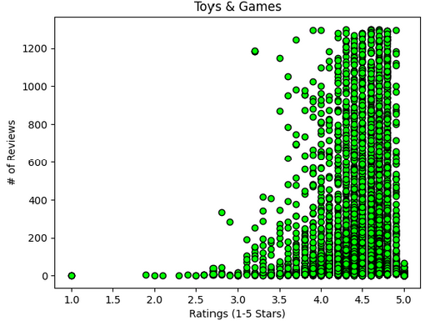
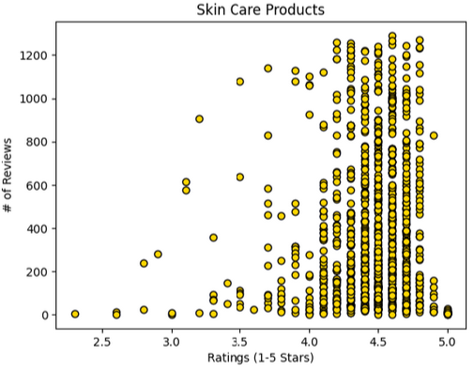
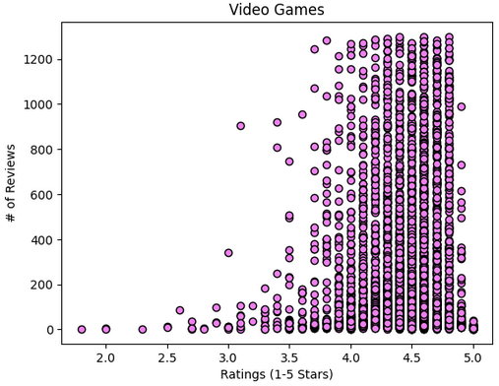
Review Count vs Average Rating By Category (Molly)
In a survey of four product categories within the data set, the number of written reviews of a product increased exponentially with the average rating of that product.
These results indicate a customer is more likely to leave a review if they have a positive impression of the product (as indicated by the rating).
We can advise the online retailer that review count can be used as an additional metric on how well-liked a product is.
Notes:
We can see based on the data that the number of reviews appear to increase exponentially the higher the average rating of the product is. This could indicate that the more positive an experience a customer has with the product (as indicated by a higher-star rating), the more likely they are to write leave a review, whereas if the customer has a pointedly negative experience with a product and leaves a low-star rating, they are less likely to leave a review detailing their experience.
Because of this, we can come to the conclusion that, in addition to ratings, count of reviews left on a product are a metric of customer satisfaction with that product. Therefore, the online retailer can use review count to measure how well-liked a product is, and determine whether or not to continue stocking that product.

Slide 17
Gender-Based Analysis of Amazon Product Data (Chorrkin)
Objective: Analyze Amazon product data to uncover differences between men's, women's, and unspecified products.
Methodology:
Gender Classification:
Classified products based on keywords in titles.
Men's Keywords: men, man, mens, male, gentlemen, boys, boy.
Women's Keywords: women, woman, womens, female, ladies, girls, girl, femme, lady.
Notes:
Slide 1: Gender-Based Analysis of Amazon Product Data
I'll be presenting our gender-based analysis of Amazon product data.
Our objective was to uncover differences among men's, women's, and unspecified products. To achieve this, we performed gender classification by analyzing product titles for specific keywords.
For Men's products, we used keywords like 'men', 'man', 'mens', 'male', 'gentlemen', 'boys', and 'boy'.
For Women's products, we included 'women', 'woman', 'womens', 'female', 'ladies', 'girls', 'girl', 'femme', and 'lady'."*

Slide 18
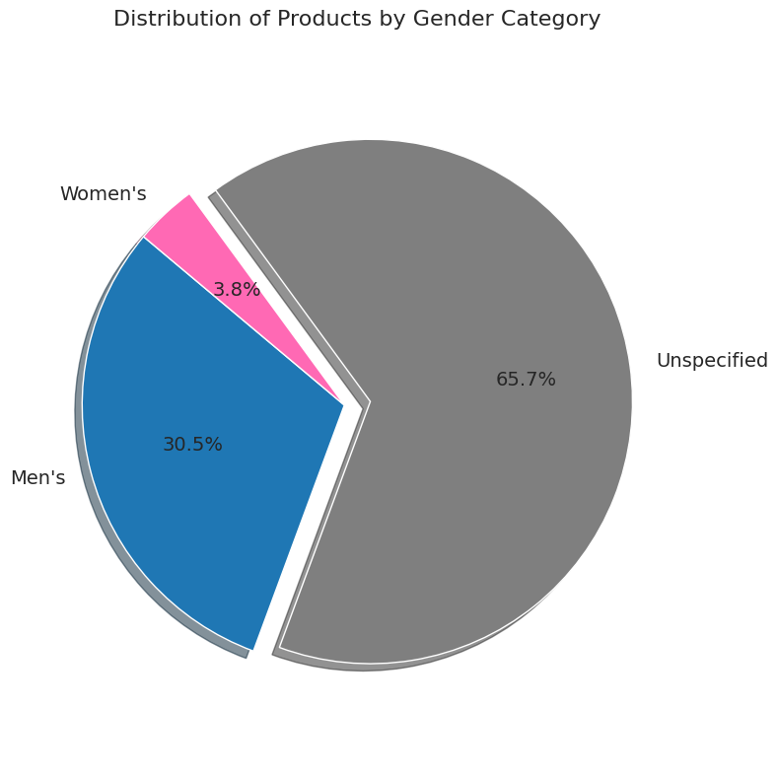
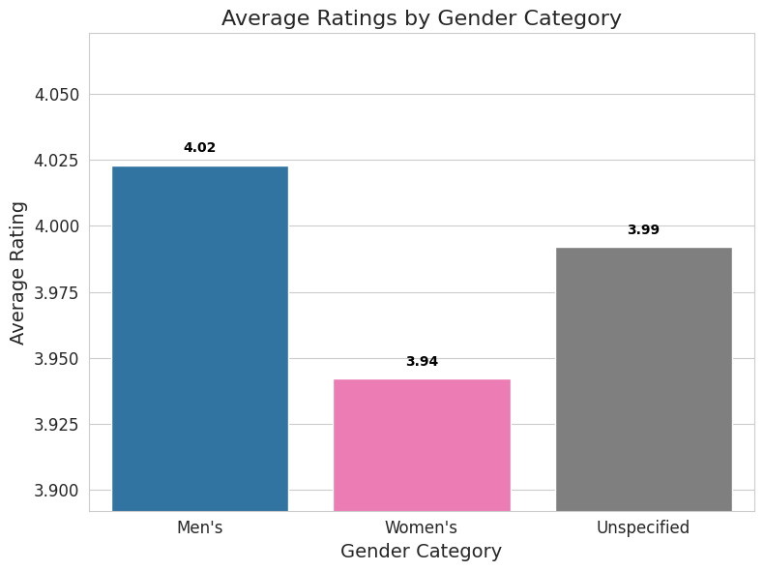
Gender-Based Analysis Results (Chorrkin)
A. Product Distribution by Gender Category
Total Products:
Men's: 434,660 (30.6%)
Women's: 54,647 (3.8%)
Unspecified: 937,030 (65.6%)
B. Average Ratings
Men's Products: 4.02
Women's Products: 3.94
Unspecified: 3.99
Notes:
Slide 2: Gender-Based Analysis Results
Our analysis revealed notable differences in product distribution and customer ratings.
These results indicate that women's products are significantly underrepresented and have slightly lower average ratings compared to men's and unspecified products.

Slide 19
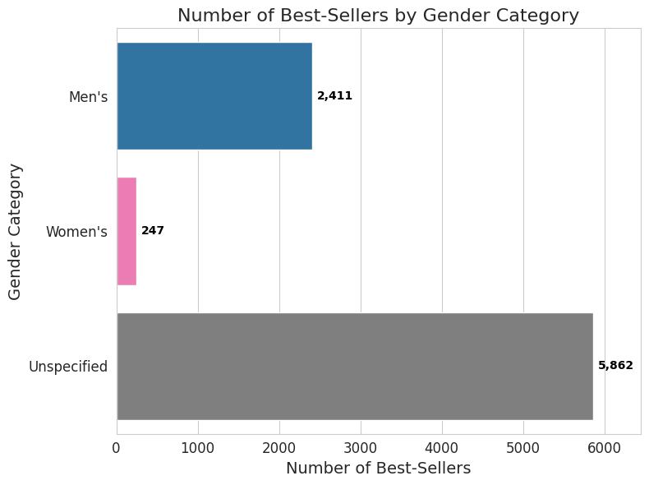
Gender-Based Analysis Insights (Chorrkin)
Number of Best-Sellers:
Men's: 2,411
Women's: 247
Unspecified: 5,862
B. Interpretations
Market Representation:
Women's products are underrepresented in the dataset.
Customer Satisfaction:
Men's products have slightly higher average ratings than women's.
Best-Seller Trends:
Unspecified category leads in best-sellers, indicating a broader market appeal.
Notes:
Slide 3: Gender-Based Analysis Insights
Diving deeper, we examined the number of best-sellers in each category.
The underrepresentation of women's products suggests a potential opportunity to expand this category.
Men's products not only have a higher presence but also slightly better average ratings.
The dominance of best-sellers in the Unspecified category indicates a broader market appeal for non-gender-specific products.
These insights can inform strategic decisions for the new e-commerce platform, such as diversifying product offerings and targeting underserved markets."*

Slide 20
Final Recommendations
Pricing
Cheaper products do better, near $22, no higher than $29
Categories
Kitchen & Dining is 2nd in average profits
1st in total purchases in the last month, largest total sales of all categories
Heath & Household is greatest in average profits by a wide margin
Holds 6th in total purchases last month
Gender Opportunity
More products targeted towards women
Offer Giftable Options
Gift cards, toys, baby-related products
Products with emotional value
Reviews as a Measure of Success
Customers are more likely to leave a review if they have a positive experience
Notes:
When giving a recommendation to the entrepreneur client on what they should focus their online retail in. Pricing wise, as Will's data showed pricing should focus on categories and products that average between 22-29 dollars ideally averaging $24. Categories to focus would be either Kitchen & Dining or Heath & Household products given Heath and Household's profitability and Kitchen and Dining’s rising popularity.

Slide 21
Thank You!

